Slide 1
Mobile IP

Slide 2
Mobile IP is a communication protocol (created by extending Internet Protocol, IP) that allows the users to move from one network to another with the same IP address.
It ensures that the communication will continue without the user’s sessions or connections being dropped.

Slide 3
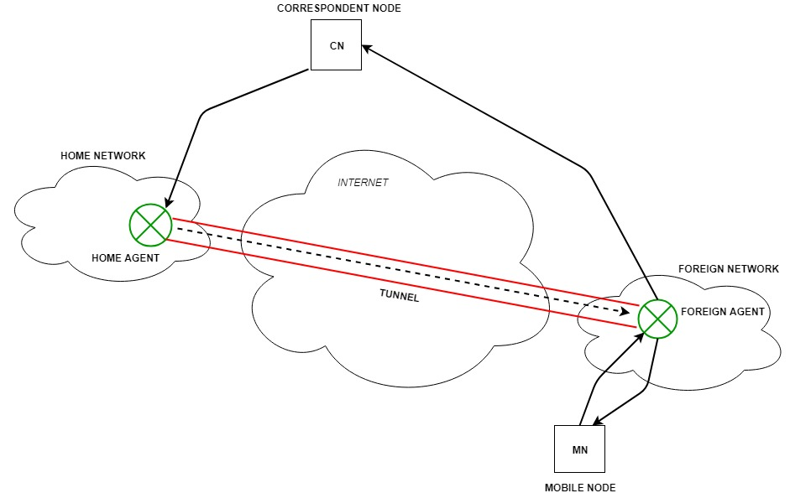
Mobile Node (MN) is the hand-held communication device that the user carries e.g. Cell phone.
Home Network is a network to which the mobile node originally belongs as per its assigned IP address (home address).
Home Agent (HA) is a router in-home network to which the mobile node was originally connected
Home Address is the permanent IP address assigned to the mobile node (within its home network).
Foreign Network is the current network to which the mobile node is visiting (away from its home network).
Foreign Agent (FA) is a router in a foreign network to which the mobile node is currently connected. The packets from the home agent are sent to the foreign agent which delivers them to the mobile node.
Correspondent Node (CN) is a device on the internet communicating to the mobile node.
Care-of Address (COA) is the temporary address used by a mobile node while it is moving away from its home network.

Slide 4
Working
Mobile IP communication protocol allows the mobile host to communicate with the remote host even if it is in a network other than its home network.
If a mobile host wants to communicate with the remote host being itself in the foreign network, then it has to go through three phases:

Slide 5
Agent Discovery: Agents advertise their presence by periodically broadcasting their agent advertisement messages.
The mobile node receiving the agent advertisement messages observes whether the message is from its own home agent and determines whether it is in the home network or foreign network.
2. Agent Registration: Mobile node after discovering the foreign agent sends a registration request (RREQ) to the foreign agent. The foreign agent, in turn, sends the registration request to the home agent with the care-of-address.
The home agent sends a registration reply (RREP) to the foreign agent. Then it forwards the registration reply to the mobile node and completes the process of registration.
3. Tunneling: It establishes a virtual pipe for the packets available between a tunnel entry and an endpoint.
It is the process of sending a packet via a tunnel and it is achieved by a mechanism called encapsulation.
It takes place to forward an IP datagram from the home agent to the care-of-address.
Whenever the home agent receives a packet from the correspondent node, it encapsulates the packet with source address as home address and destination as care-of-address.

Slide 6
The correspondent node sends the data to the mobile node. Data packets contain the correspondent node’s address (Source) and home address (Destination).
Packets reach the home agent. But now mobile node is not in the home network, it has moved into the foreign network.
The foreign agent sends the care-of-address to the home agent to which all the packets should be sent. Now, a tunnel will be established between the home agent and the foreign agent by the process of tunneling.
Tunneling establishes a virtual pipe for the packets available between a tunnel entry and an endpoint. It is the process of sending a packet via a tunnel and it is achieved by a mechanism called encapsulation.
Now, the home agent encapsulates the data packets into new packets in which the source address is the home address and destination is the care-of-address and sends it through the tunnel to the foreign agent.
Foreign agent, on another side of the tunnel, receives the data packets, decapsulates them, and sends them to the mobile node. The mobile node in response to the data packets received sends a reply in response to the foreign agent. The foreign agent directly sends the reply to the correspondent node.

Slide 7
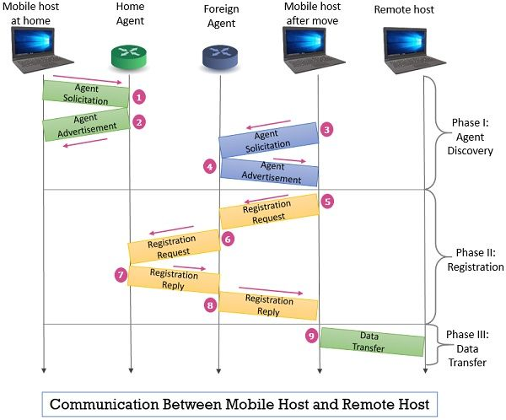
Agent Discovery (Phase I)
Agent discovery is the first phase and requires the involvement of a mobile host, a home agent and a foreign agent. This phase also has two sub-phases as described below:
The mobile host has to discover the home agent’s address before it moves away from the home network.
As the mobile host moves to a new network (foreign network), it has to discover the foreign agent’s address and also the care-of address.

Slide 8
The agent discovery phase includes two types of messages: agent advertisement and agent solicitation.
Agent Advertisement
A simple router advertises its existence on the network with the ‘ICMP (Internet Control Message Protocol)router advertisement’ packet. If the router is playing the role of an agent, it ‘appends’ the agent advertisement message to the ICMP advertisement packet.
If the advertisement is done by a foreign agent, then it sends a ‘list of addresses’ available as care-of addresses.

Slide 9
The agent discovery phase includes two types of messages: agent advertisement and agent solicitation.
Agent Solicitation
In case, if a host in the network doesn’t receive the ‘router ICMP advertisement’ packet. The host can initiate itself by sending the ‘router ICMP solicitation packet’. If a mobile host has not received the ‘agent advertisement’, it can use the ‘router ICMP solicitation packet’ to send the ‘agent solicitation’ message.

Slide 10
Registration (Phase II)
This is the second phase and it also requires the involvement of a mobile host, a home agent and a foreign agent.
After discovering the home agent and foreign agent address the mobile host has to register itself to the foreign agent and the home agent.
The mobile host has to renew its registration if it has expired. While returning back to the home network the mobile host has to cancel or deregister its registration.
This registration process involves two messages: registration request and registration reply. These registration messages are first encapsulated in a UDP user datagram.
Data Transfer (Phase III)
After the agent discovery and registration process, the mobile host is in the foreign network and can communicate with the remote host.

